Slide 1
Let’s get physical
with Python
© CC BY-SA 4.0

Slide 2
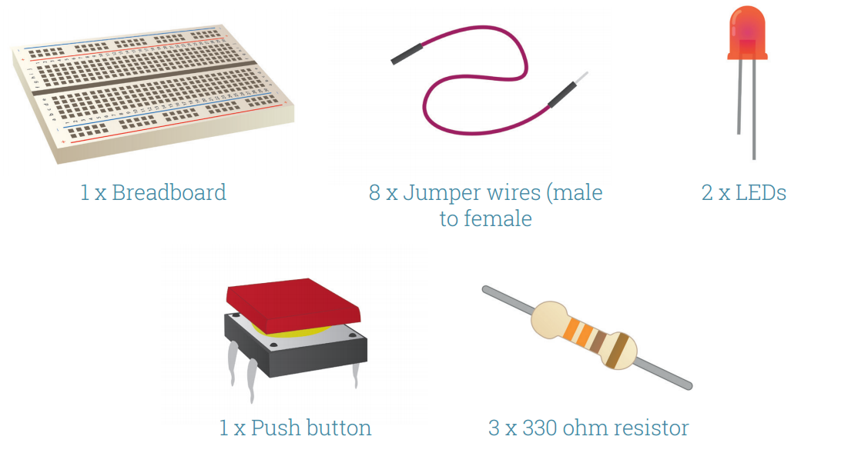
Workshop outline
Why physical computing
Build simple circuit using Raspberry Pi
Control an output using Scratch on Raspberry Pi
Create more complex circuits and programs
You will need:

Slide 3
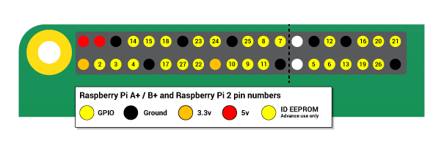
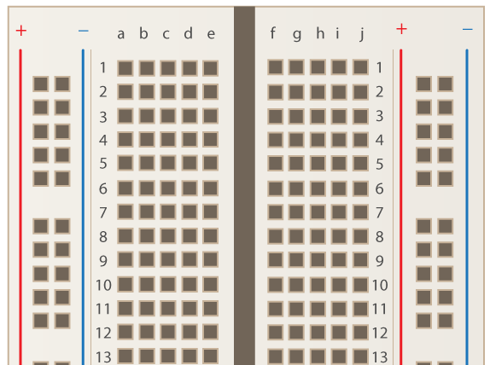
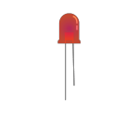
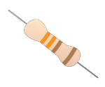
Physical Computing
Enables creators to connect the virtual world with the physical, great for engagement.
Notes:
Engagement
Simple activities are powerful for students
GPIO - analogy of a battery. Ground are the flat end.

Slide 4
Simple Circuit
Your Raspberry Pi can act as the power supply for simple circuits, we can use this test our hardware is working.
Notes:
4th grade NGSS standard in U.S.

Slide 5
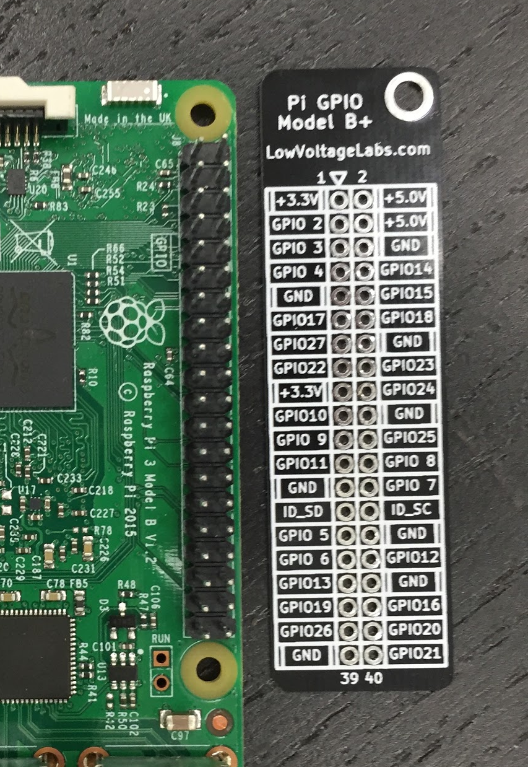
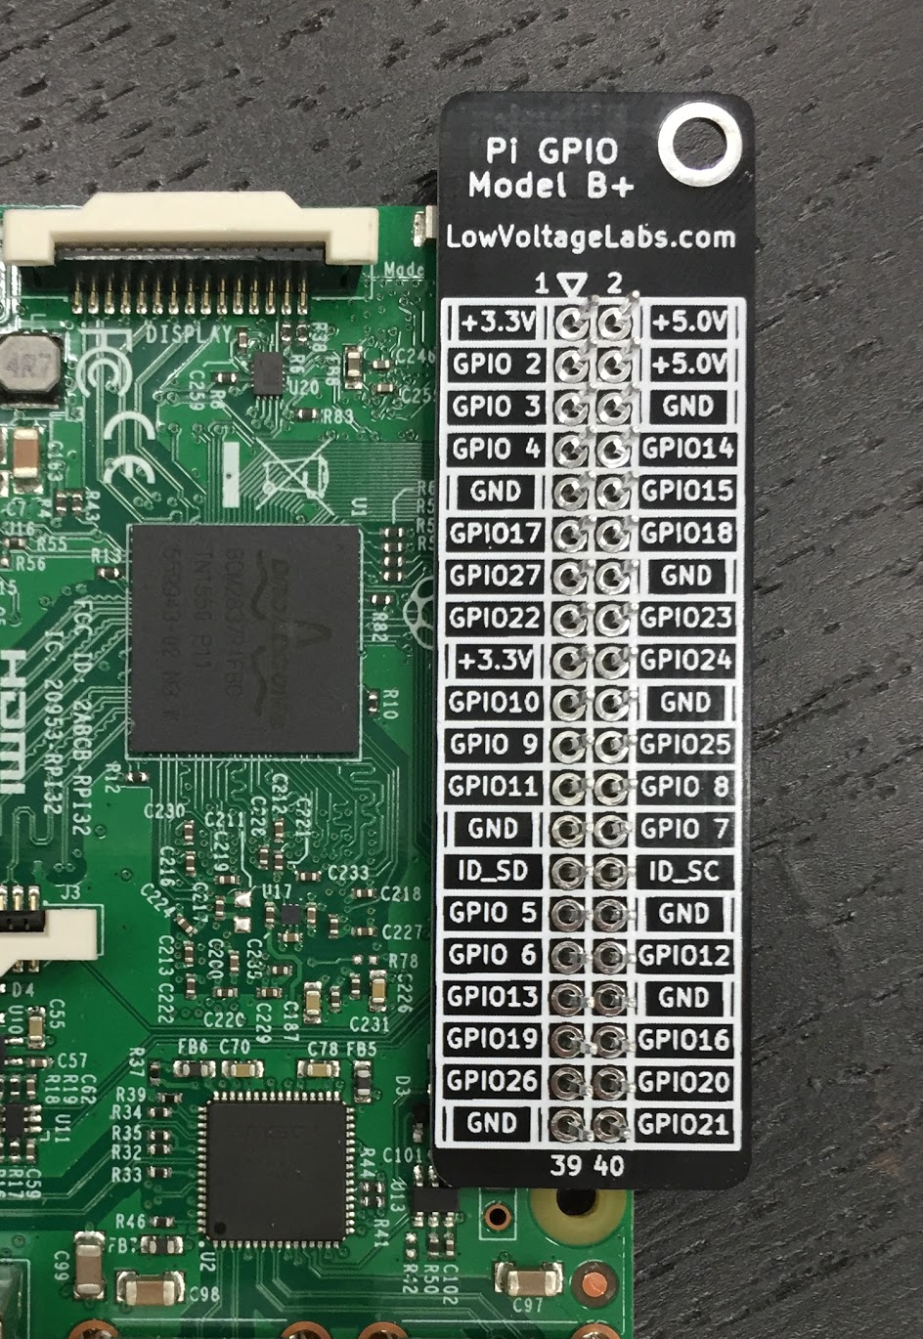
GPIO reference board
Ensure the board is the right way up

Slide 6
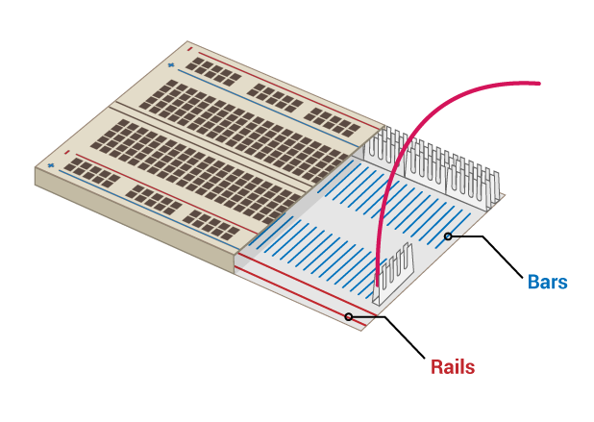
Inside a breadboard

Slide 7
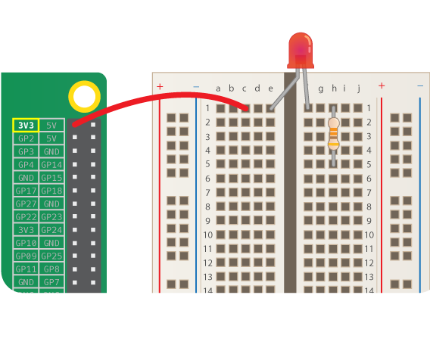
Simple Circuit
Your Raspberry Pi can act as the power supply for simple circuits, we can use this test our hardware is working.

Slide 8
Simple Circuit
Your Raspberry Pi can act as the power supply for simple circuits, we can use this test our hardware is working.

Slide 9
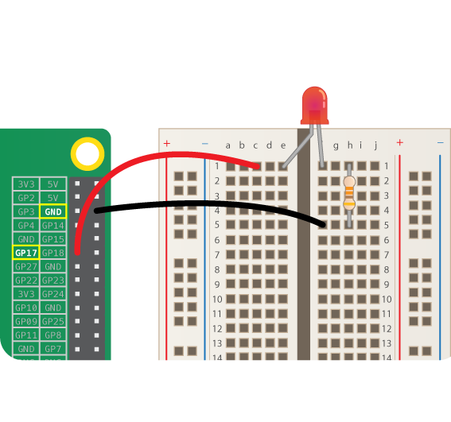
Switching Circuit
Your Raspberry Pi can act as a switch in the circuit, which can be controlled in software. Connect the positive leg of the LED to GPIO pin 17 on your Raspberry Pi

Slide 10
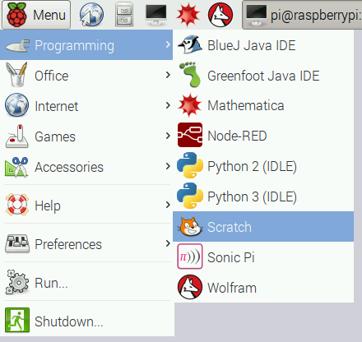
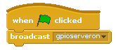
Scratch on the Raspberry Pi
Open Scratch and activate the GPIO server.
gpioserveron

Slide 11




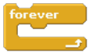
Blinking LED
Setup your pin (17) as an output. |  | config17out
Switch pin 17 on |  | gpio17on
Switch pin 17 off |  | gpio17off
Pause
Loop forever
Can you:
Flash your LED at different speeds, how fast can you make it flash?
Can you make a dot (short flash) and dash (long flash) and use to make a distress beacon. S(...) O(---) S(...)
Add more LEDs to create a set of traffic lights and program an appropriate sequence.
Use another form of output such as a buzzer or motor.
Incorporate physical output into your other scratch projects

Slide 12
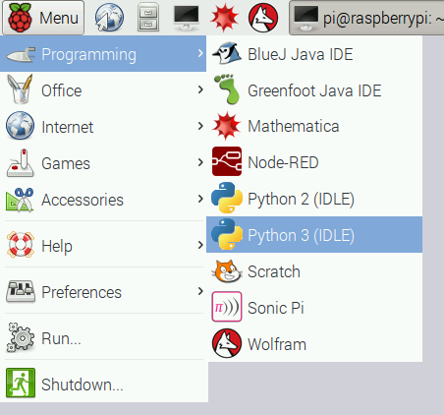
Create New Python 3 File

Slide 13
Example Programs
# Flashing LED
from gpiozero import LED
from time import sleep
led = LED(17)
while True:
led.on()
sleep(1)
led.off()
sleep(1)
Notes:
Add url for docs https://gpiozero.readthedocs.org/en/v1.2.0/
This Python code is equivalent to the previous Scratch blocks.
To run the code:
Menu → Programming → Python 3 (IDLE)
Click File then New File
Type out the Python Code
Press F5 to run the code (saving it first)
The ## red comments are merely annotation and ignored by the computer.

Slide 14
Example Programs
# Flashing LED
from gpiozero import LED
led = LED(17)
led.blink()
Try some other values in led.blink(), what would these do:
led.blink(5)
led.blink(2, 0.5)
led.blink(0.1, 10)
led.blink(0.5, 0.5, 5, False)
Notes:
When would we use these different approaches

Slide 15
Example Programs
# LED methods from the docs
https://gpiozero.readthedocs.io
led.on() - Switches the Pin high
led.off() - Switches the Pin low
led.blink() - Makes the LED blink
led.toggle() - Change the state of the LED
led.pin.number - Returns the pin number
led.is_lit - Returns the current state
What teaching activities could you build around a single controllable LED?
Morse code
Twitter notification
Reaction game
What can you make your single LED do in 5 mins?
How is a buzzer different?
Notes:
Add url for docs https://gpiozero.readthedocs.org/en/v1.2.0/

Slide 16
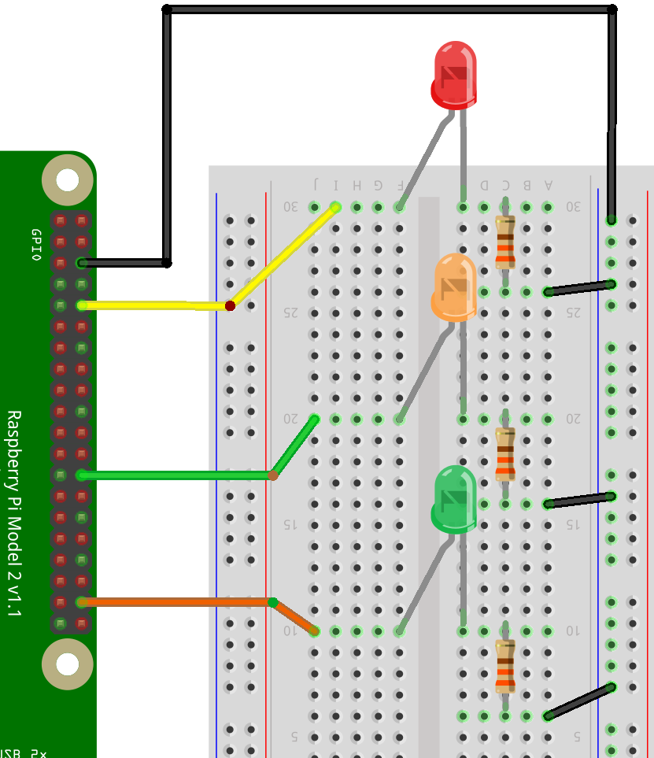
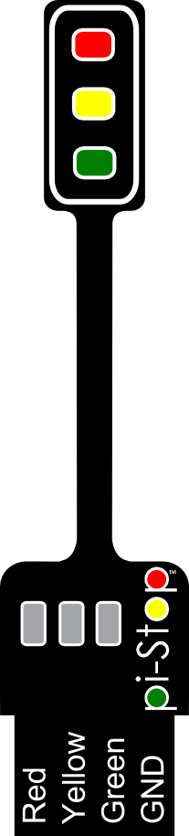
Multiple LEDs
With just a few more wires we can create something a little more complex…
Add at least 1 more LED
Create an interesting sequence
What challenges and opportunities does an activity like this present?
Notes:
Traffic Hat

Slide 17
Abstraction
Notes:
Traffic Hat

Slide 18
Abstraction
Removing complexity to make a task more accessible
# Traffic Lights
from gpiozero import LED
from time import sleep
red = LED(21)
amber = LED(20)
green = LED(16)
red.on()
sleep(3)
red.off()
amber.on()
…
# Traffic Lights
from gpiozero import TrafficLights
from time import sleep
lights = TrafficLights(21, 20, 16)
lights.red.on()
sleep(3)
lights.red.off()
lights.amber.on()
…
Notes:
Traffic Hat

Slide 19
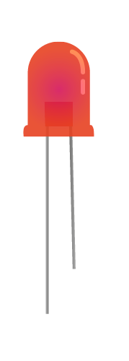
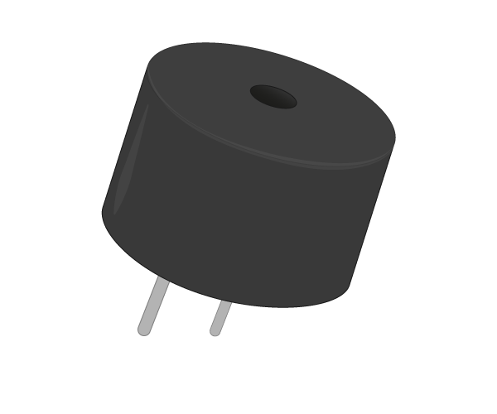
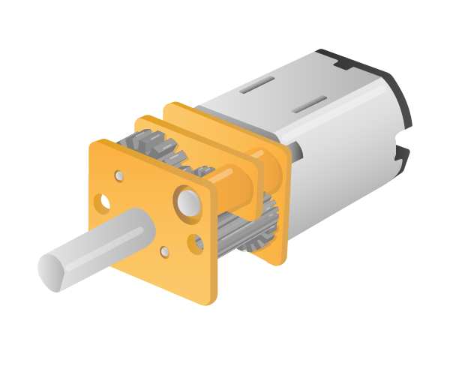
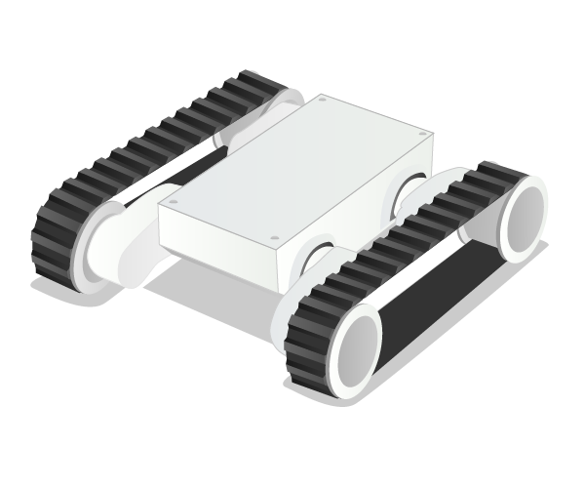
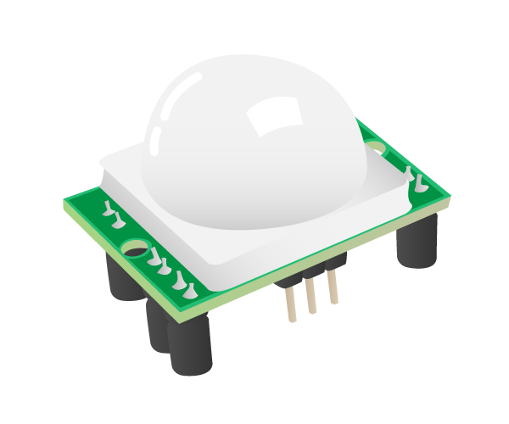
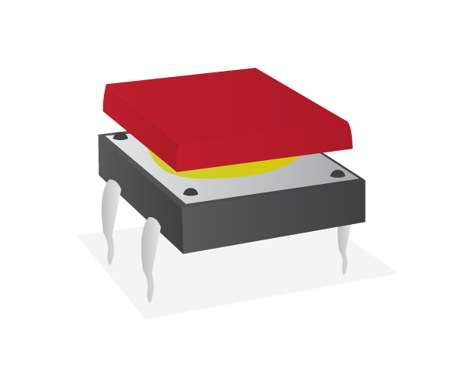
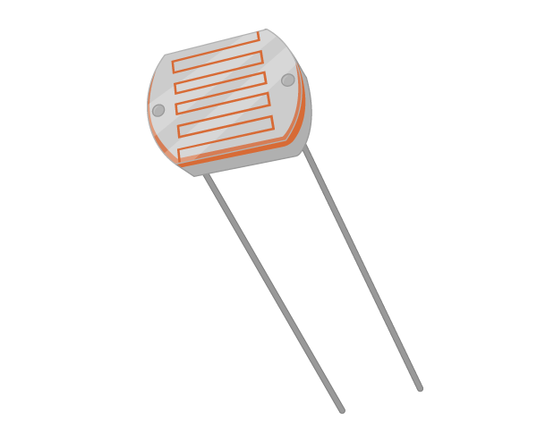
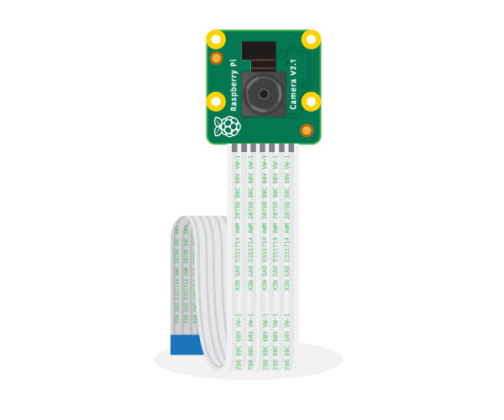
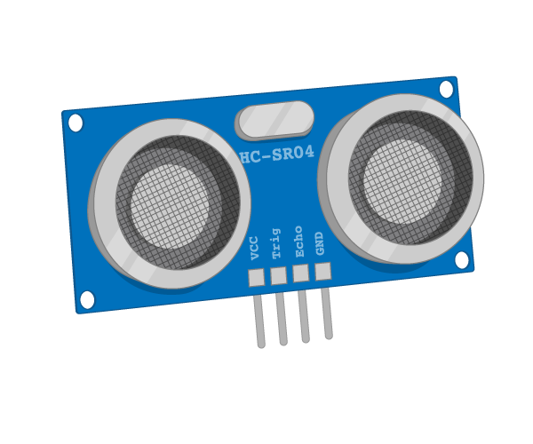
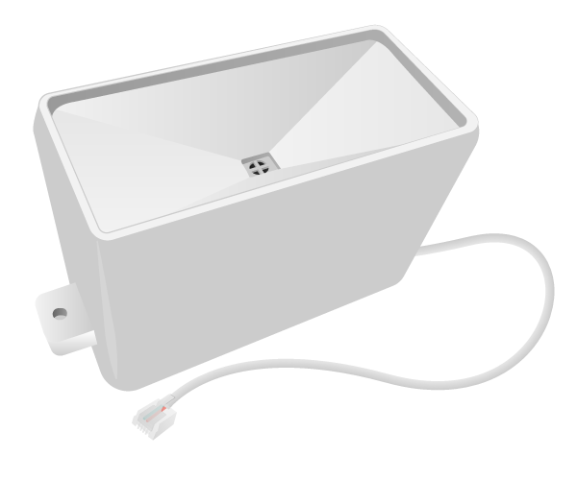
Where next?

Slide 20
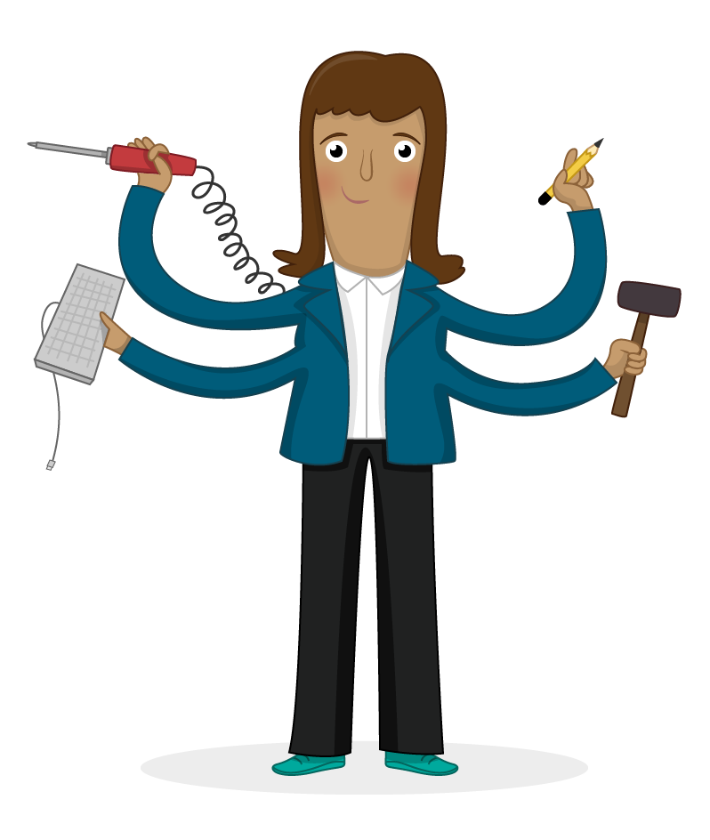

Digital making, STEAM, project-based learning, and tinkering are at the core of our teaching philosophy which can be summed up simply as ‘we learn best by doing’.
We’ve defined our own digital making curriculum that will help people everywhere learn new skills.
It is for self-guided learners, parents, teachers and people who run digital making clubs at schools, community centres, and Raspberry Jams.
Check out our Digital Making curriculum at rpf.io/curriculum
The Raspberry Pi Foundation’s
Curriculum for Digital Making

